Slide 1
Smart Glove Control System
Team 2
Ata Gün Öğün
Charles Donven
Yucong Ma

Slide 2
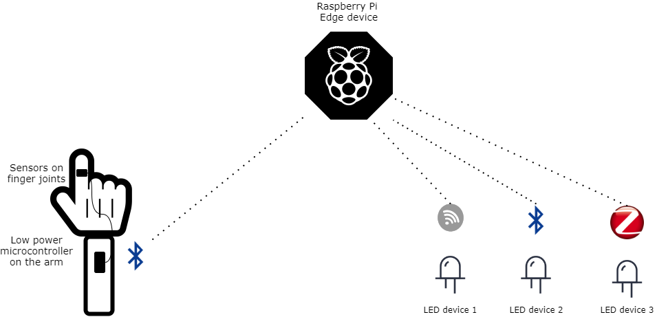
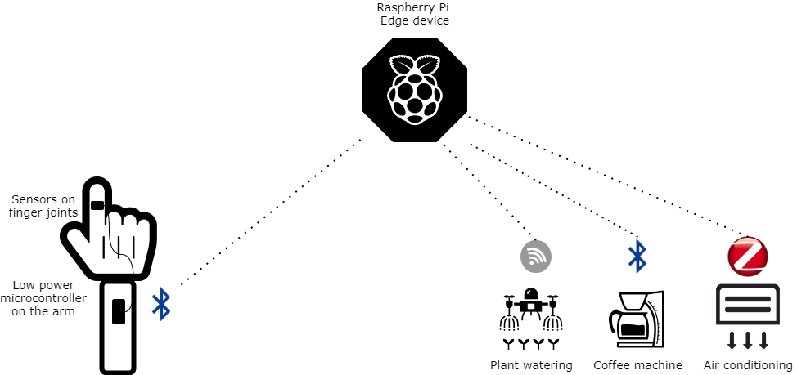
General Idea (recap)
Control messages
Sensor data

Slide 3
General Idea (recap)
Control messages
Sensor data

Slide 4
Progress Plan
Sprint 1 (8 May - 21 May)
Configure movement sensors, connect them to edge device, and first prototype of the glove
Sprint 2 (22 May - 4 June)
Recognize and interpret hand movement patterns on edge device
Sprint 3 (5 June - 25 June)
Control simple IoT devices using commands from finger movements
Sprint 4 (26 June - 9 July)
Recognize more gestures, and control more advanced IoT devices and Provide framework add new devices

Slide 5
Sprint 1 Recap
What has been done:
Raspberry pi and microcontroller communication using UDP
Raspberry pi and microcontroller communication using MQTT
Research on machine learning methods for gesture recognition.
Research on machine learning methods for gesture recognition.
Research on existing IMU libraries to simplify communication between IMU and microcontroller.

Slide 6
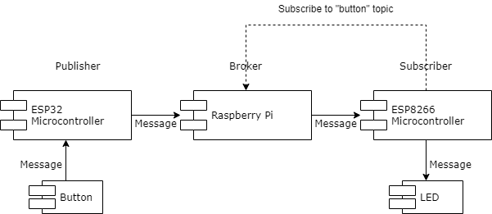
Sprint 1 Recap
MQTT Communication Mechanism:

Slide 7
Sprint 1 Recap
What was missed out:
We additionally ordered IMU sensors and flex sensors for the glove, but those have not arrived yet. Therefore, the hardware configuration for the prototype was not done.

Slide 8
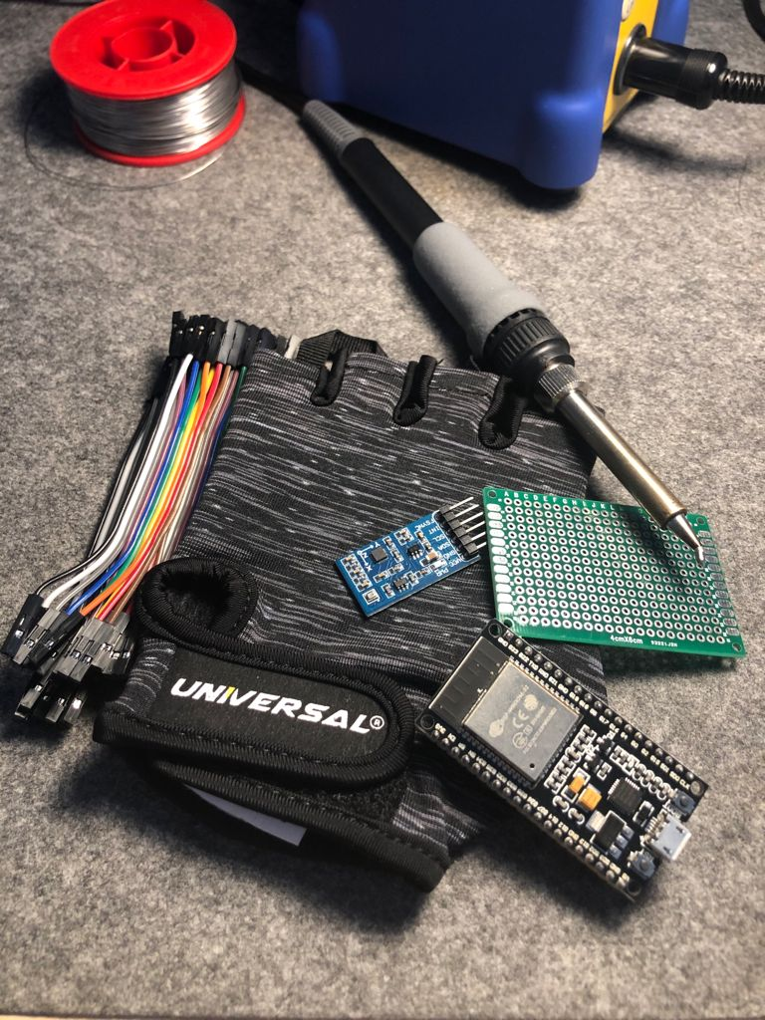
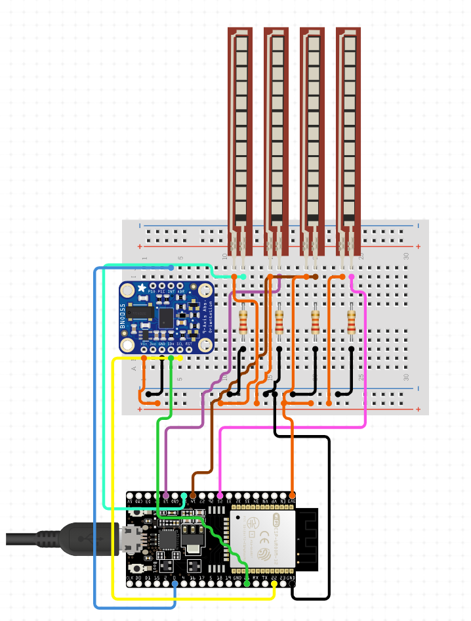
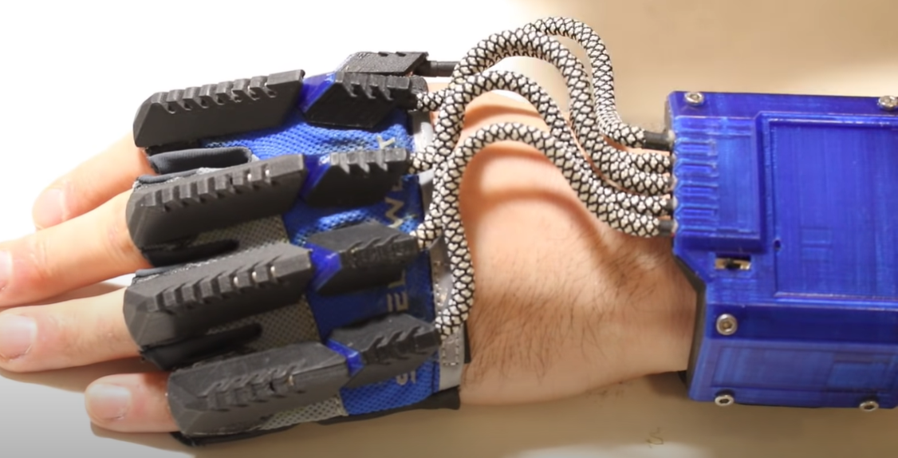
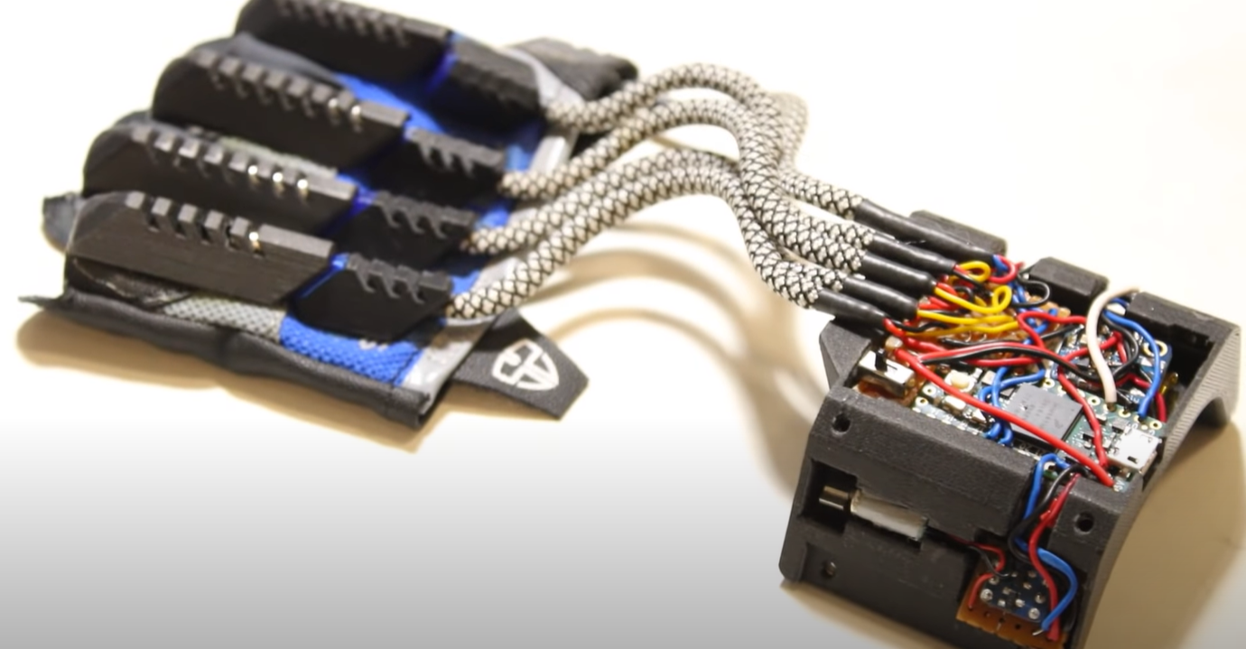
Voidstar Lab Somatic Data Glove
Notes:
If we can learn how to do 3d modeling, we are aiming to do an enclosure similar to the one on the right (GOTO NEXT SLIDE)

Slide 9
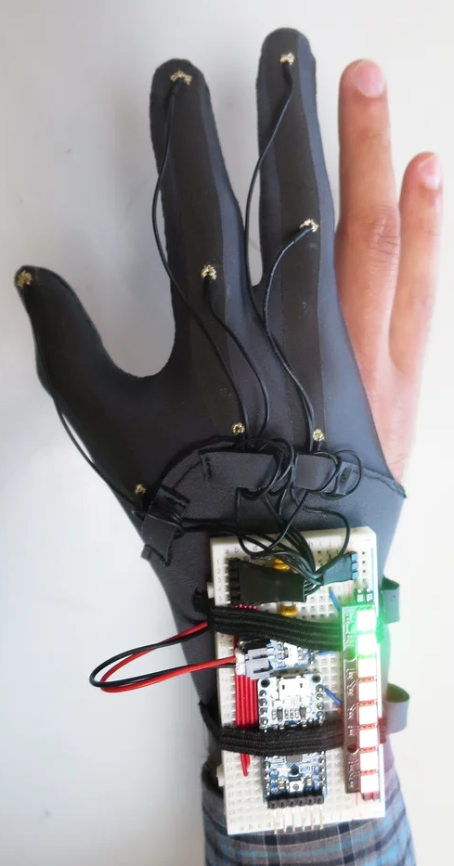
DIY Glove Controller With E-Textile Sensors @Instructables
Notes:
But if we can’t learn 3d modeling and printing quickly, we will start collecting data with a setup similar to this, so that we can test our machine learning approach.

Slide 10

Notes:
There are lots of different methods we can use, this diagram helps us narrow down our options

Slide 11
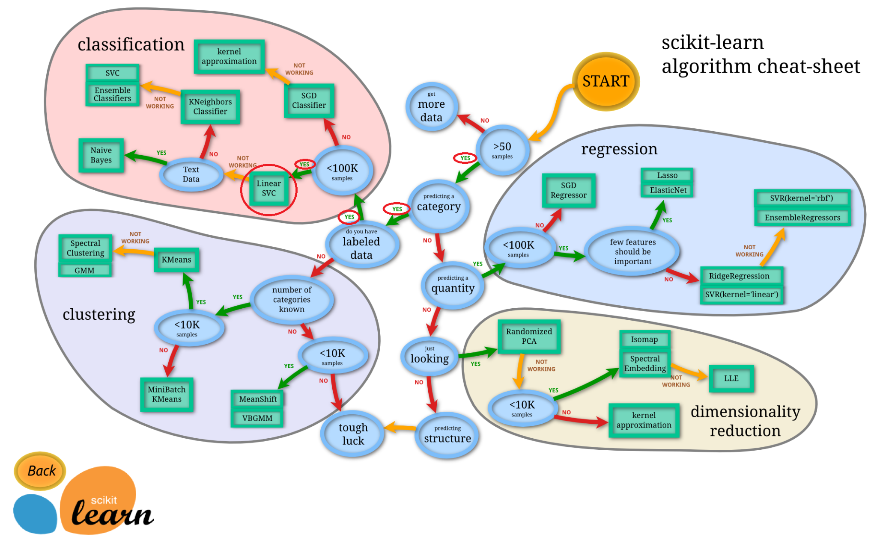
Notes:
The diagram suggests we should first try the “Linear SVC” algorithm.

Slide 12
Sprint 2 Plan
When the IMU sensors and flex sensors arrive, configure those sensors and assemble the prototype.
Compare UDP and MQTT in detail, also try to configure bluetooth and figure out which communication mechanism suits better
Implement a data collection utility to collect labeled data for training the machine learning models. Test which one works best.
Try to implement gesture recognition methods using proper machine learning models

Slide 13
Thank you!
Questions?

Slide 14
References

